Slide 1
Snake
Підготували
Кінаш Роман,
Родич Олександр,
Закохайло Марина,
Яремко Мирослав,
Косован Василь

Slide 2
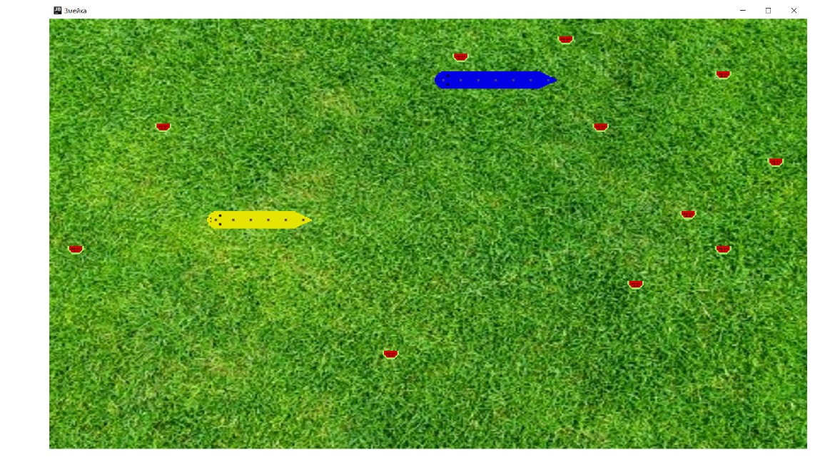

Slide 3
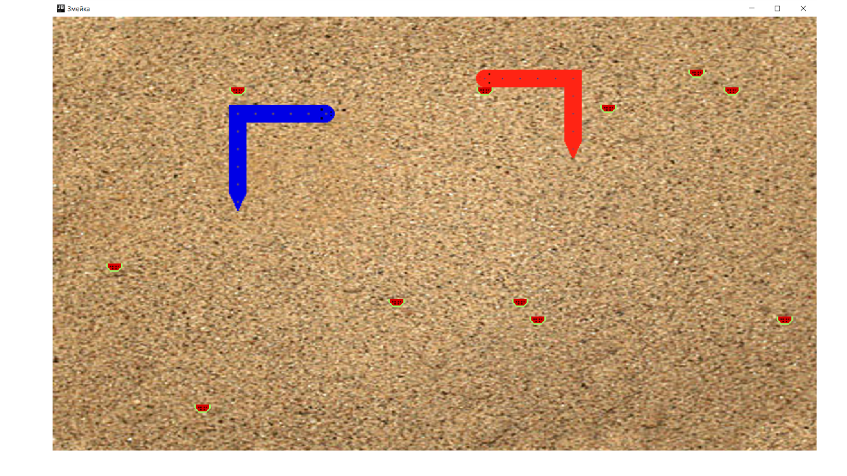

Slide 4
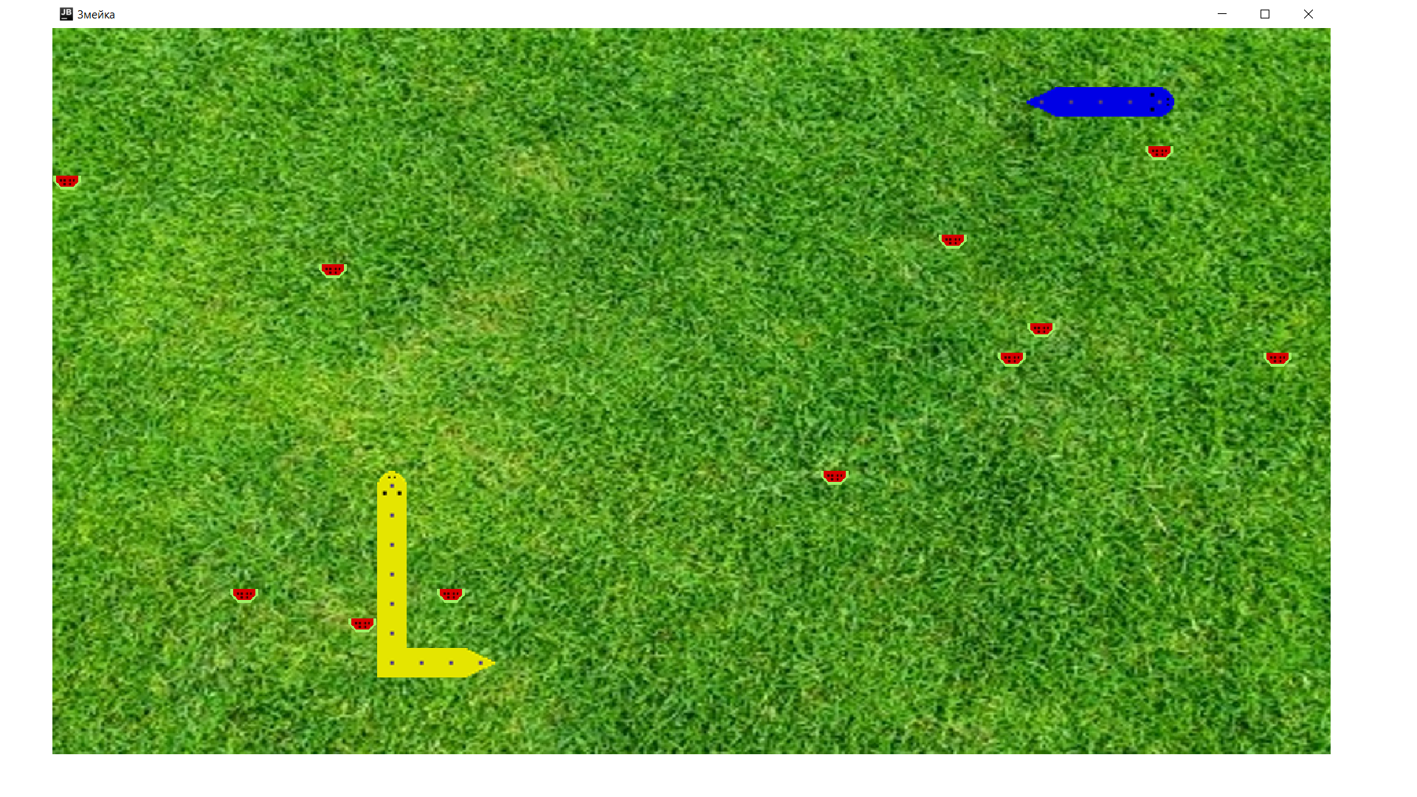

Slide 5
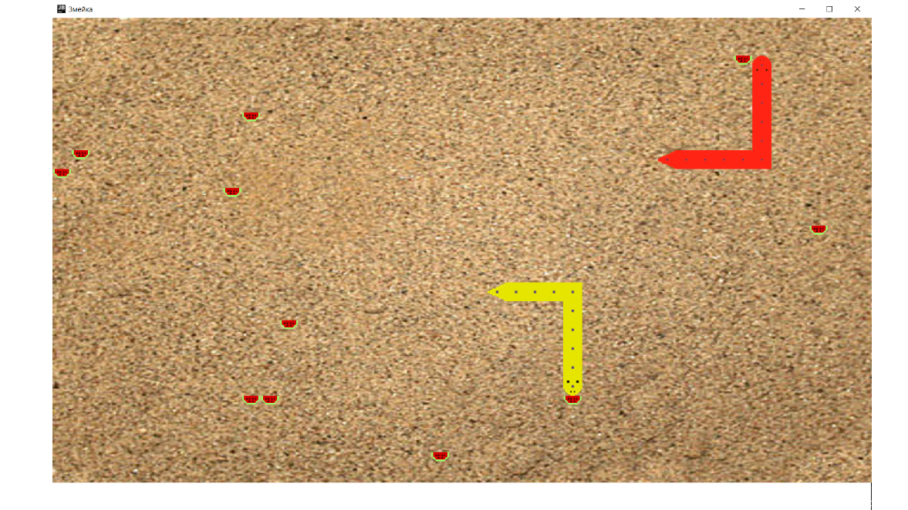

Slide 6
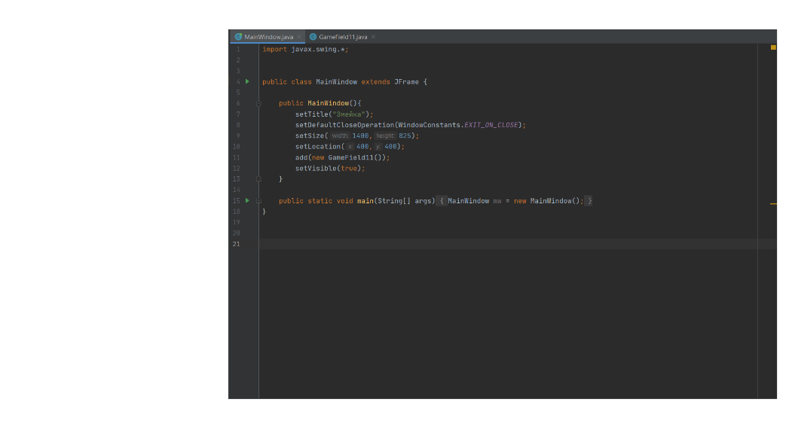
The content of the game
You might say that you can enter any website with games and find Snake there. But have you ever seen the Snake for two? Thanks to new functions you'll be able to play with your friend together.
Classes: MainWindow, GameField.

Slide 7
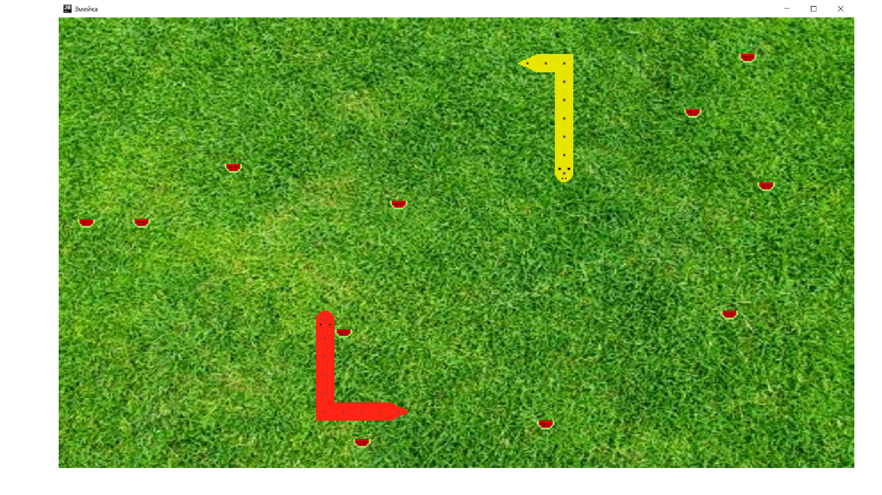

Slide 8
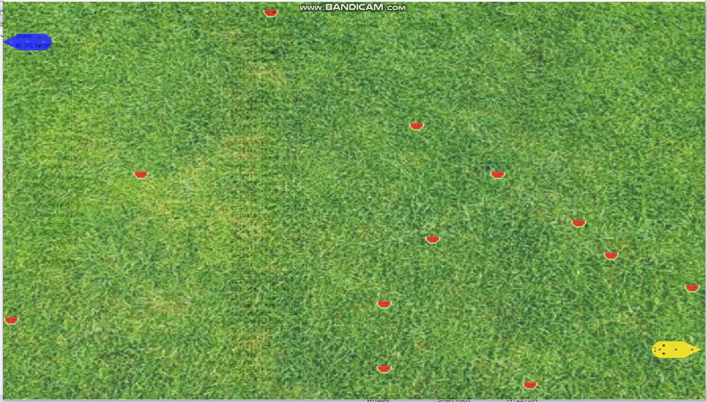

Slide 9
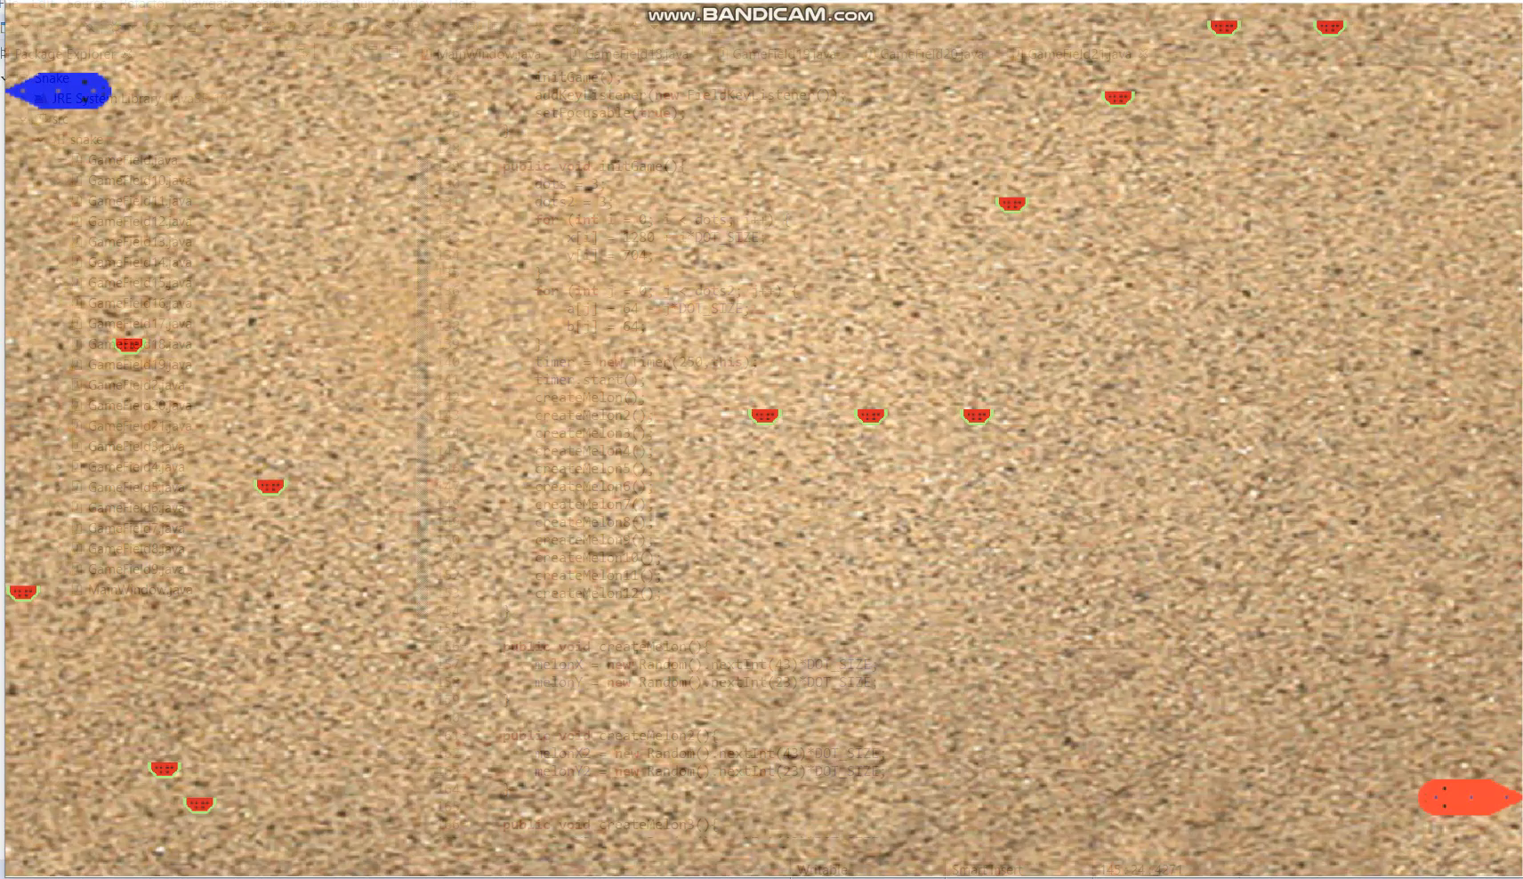

Slide 10
Дякую за увагу!

